Slide 1
PARTHOS
When only pleasant acoustics are not enough

Slide 2
PARTHOS
Acoustic comfort – the challenge of the modern office
Acoustic columns are one of the solutions that can achieve the desired acoustic balance in different spaces. Best of all, they require no special fixings, thus giving you more freedom and flexibility.
Notes:
A noisy work or relaxation environment can significantly reduce the quality of work and the overall well-being of employees. A room that is too soundproof can cause discomfort as well. Therefore, architects and designers shall not only decide how to plan office spaces efficiently and create modern interiors but also how to ensure acoustic comfort. The size and form of spaces as well as the materials and furniture used in them affect the propagation of sound waves. Sound propagates at different frequencies and therefore requires different ways to control it.
Acoustic solutions can be mounted on ceilings, walls or desks. However, in some cases, acoustic products cannot be mounted neither on ceilings nor on walls. This calls for flexible solutions – free-standing acoustic products that can be moved to a different place if needed. Acoustic columns are one way you can achieve acoustic balance in different spaces.

Slide 3
PARTHOS
PARTHOS – a stylish, mobile and sustainable product
Notes:
PARTHOS is a stylish, mobile and sustainable product that not only improves the acoustics of spaces but also makes the environment more functional.

Slide 4
PARTHOS
Notes:
Although the main purpose of PARTHOS is to improve the acoustics of a space, it is also a stylish design element that adds a unique touch to contemporary interiors.

Slide 5
PARTHOS
PARTHOS distinctive qualities
Ensured acoustic features.
Wide range of functional applications.
Sustainable design.

Slide 6
PARTHOS
Ensured acoustic features
Notes:
PARTHOS is an acoustic product with the technical properties necessary to ensure pleasant ambient acoustics.

Slide 7
PARTHOS
Muffles all three types of sound frequencies
Svarbu, kad nebūtų pavaizduota kad tik žemus dažnius slopina - vidutinius ir aukštus slopina ypatingai gerai, bet ir žemus, lyginant su kitais produktais.
High-frequency sounds
Medium-frequency sounds
Low-frequency sounds
Notes:
Ambient sound is divided into high-, medium- and low-frequency sounds. High-frequency sounds are, for example, phone calls, medium-frequency sounds are human speech, and low-frequency sounds are usually caused by heating, ventilation and air conditioning systems.
Acoustic screens or panels are excellent at muffling high- and medium-frequency noise. Due to their size and the materials they are made of, acoustic columns offer excellent attenuation of all three types of sound. By combining different NARBUTAS acoustic solutions, you can create acoustic comfort and a stylish environment for your employees.

Slide 8
PARTHOS
Careful selection of materials
Notes:
When creating acoustic columns, we thought carefully about which materials would provide good sound absorption, reduce reverberation and be sustainable. We filled PARTHOS with textile offcuts from manufacturing, which have excellent sound-absorbing properties. It is covered with PET felt, which is porous and enhances these properties. The choice of pattern also contributes to the improvement of acoustics by dispersing some of the sound waves.

Slide 9
PARTHOS
Wide range of functional applications
Notes:
PARTHOS is a distinctive product because it has other functions in addition to its main purpose of absorbing ambient sound. This allows you to use these acoustic columns in a variety of situations.

Slide 10
PARTHOS
Four different types of acoustic columns
Notes:
The PARTHOS collection consists of four types of acoustic columns. Let’s talk a little bit more about each of them.

Slide 11
PARTHOS
An acoustic column
1600 mm
1200 mm
800 mm
Notes:
An acoustic column without additional accessories serves its main purpose of absorbing sound. You can choose from three different heights – 800 mm, 1200 mm, and 1600 mm.

Slide 12
PARTHOS
An acoustic column with hooks
Notes:
An acoustic column with hooks is an acoustic product with a distinctive design that can be easily integrated into meeting spaces. You can use hooks to hang your clothes, handbags or bags. The acoustic column has six hooks. One hook can support up to 2 kg.
Acoustic columns with hooks are 1600 mm high.

Slide 13
PARTHOS
An acoustic column with space for a plant pot
Notes:
An acoustic column with space for a plant pot allows you to create a biophilic design that will brighten up any interior. This solution is suitable for big meeting rooms, relaxation areas in public spaces and much more. Multiple columns placed side by side can also be used for zoning.
Acoustic columns with spaces for plant pots come in three heights – 800, 1200, 1600 mm.

Slide 14
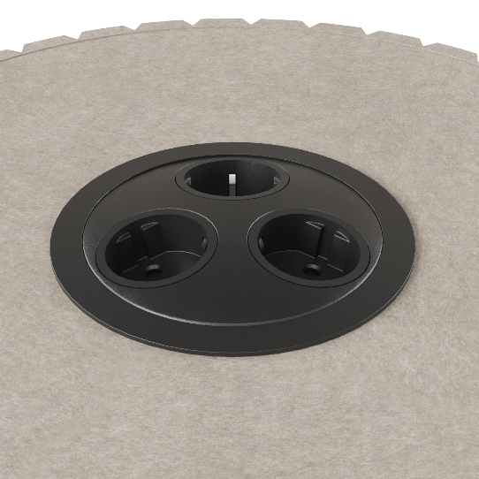
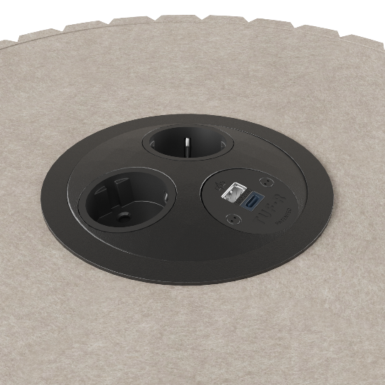
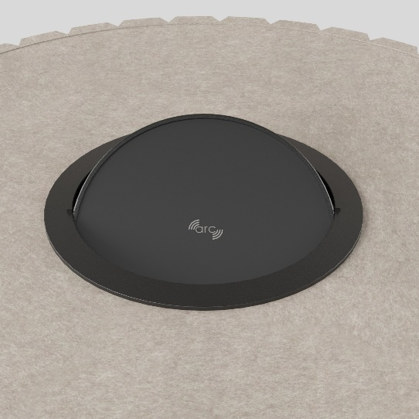
PARTHOS
An acoustic column with a power socket unit
Notes:
Choose an 800 mm high acoustic column with the most suitable electric charging station. There are four different types to choose from
(with 3 AC power sockets, 2 AC power sockets and 1 USB type-A+C socket, 3 AC power sockets and a wireless charger or 2 AC power sockets, 1 USB type-A+C socket and a wireless charger).
An acoustic column with a power socket unit is ideal for meeting rooms or relaxation areas next to lounge seaters. You can use it to charge your smart devices with ease and continue your work or conversation.

Slide 15
PARTHOS
A comfortable relaxation area
Notes:
A relaxation area is also a great place where PARTHOS acoustic columns will blend in seamlessly. You can charge your phone or computer while sitting on the lounge seater.

Slide 16
PARTHOS
Public space dividing
Notes:
In large public spaces, PARTHOS can help to manage the traffic of people and divide areas for different uses.

Slide 17
PARTHOS
Easily applicable in historic buildings
Kultūros paveldo erdvė. Baltas.
Akcentas į PARTHOS: akustika, kai turime daugybę apribojimų.
PARTHOS akustinės kolonos . FORUM posėdžių stalai
Notes:
Cultural heritage or historic buildings usually have many constraints that make it difficult to renovate such spaces, for example, fixing to walls or ceilings is not always possible. Acoustic columns are a quick and easy solution for creating a comfortable acoustic environment in these types of buildings.

Slide 18
PARTHOS
Thoughtful details in the executive office
Notes:
PARTHOS is also perfect for the refined and sophisticated executive office, where its visitors will find a convenient place to hang up their coats.

Slide 19
PARTHOS
Sustainable design
Notes:
Sustainability is one of NARBUTAS strategic long-term directions, and PARTHOS is one of our products that meets the principles of sustainable design.

Slide 20
PARTHOS
Textile offcuts from manufacturing – the main acoustic material
Notes:
Foam is commonly used in the manufacture of acoustic products, but we have deliberately chosen a more sustainable solution. The PARTHOS acoustic column is filled in an environmentally friendly way – with upholstery offcuts from manufacturing that are no longer suitable for production but have excellent acoustic properties.

Slide 21
PARTHOS
PET felt – a sustainable design element with acoustic properties
Notes:
Our acoustic columns are covered with PET felt, which looks like wool but is actually made of plastic and uses more than 50% recycled plastic. In total, PARTHOS uses a minimum of 32% recycled materials, which include metal, PET felt, textile offcuts from manufacturing.

Slide 22
PARTHOS
Textile offcuts
Provides stability
Enhances sound absorption
PET felt
≥ 50% recycled plastic
100% recyclable material
Easy to disassemble, sort and recycle
Notes:
Easy product disassembly, sorting and recycling are among the key principles of sustainable design. And PARTHOS acoustic columns satisfy all of these things perfectly.

Slide 23
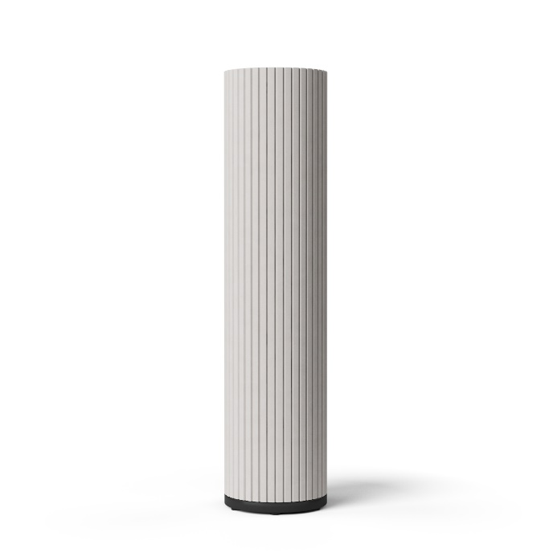
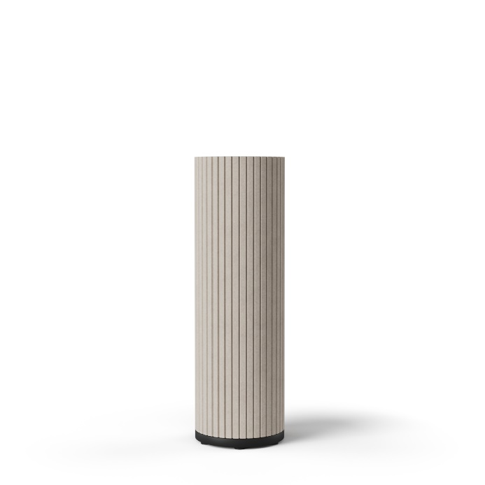
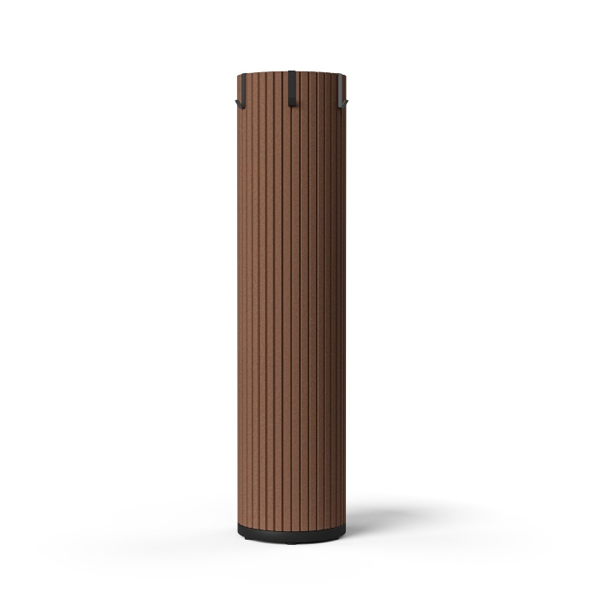
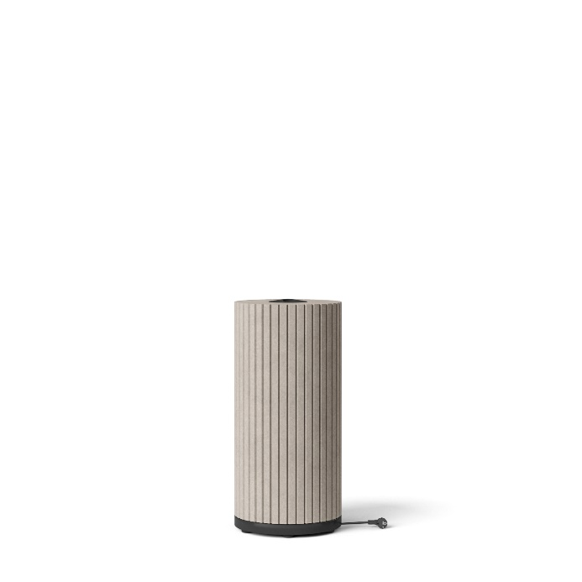
PARTHOS
Acoustic column | Acoustic column with space for a plant pot | Acoustic column with hooks | Acoustic column with a power socket unit
800 / 1200 / 1600
1600
800 / 1200 / 1600
800
Plant pot dimensions:
Ø230, H = 170 mm
Hook capacity: 2 kg.
Standard:
EU / FR / UK / CH / US*
* No wireless charger available.
PET felt

Slide 24
narbutas.com

